Slide 1


SYSTEM MODELING and DESIGN For A Disaster Management Mobile Application
Dr. NKEMENI Valery, PhD
Course Facilitator:

Slide 2
Presented By
Group Two
NAMES | MATRICULE
QUINUEL TABOT NDIP-AGBOR | FE21A300
SIRRI THERESIA ANYE | FE21A306
NGONCHI RAMATOU YOLAND | FE21A260
CHE BLAISE NJI | FE21A157
LIMA CHARLES | FE21A225

Slide 3
01. INTRODUCTION
04. CLASS DIAGRAM
02. CONTEXT DIAGRAM
05. SEQUENCE DIAGRAM
03. USE CASE DIAGRAM
06. DEPLOYMENT DIAGRAM
Table Of Contents
You can describe the topic of the section here
Design the system’s structure and relationships.
Define the system’s scope and external interactions.
Model the dynamic interactions and behaviors.
Capture the functional requirements and interactions..
Plan the physical deployment of the system.

Slide 4

01
INTRODUCTION
Disaster management is a critical area that requires efficient and effective coordination among various stakeholders and users. Mobile applications can play a significant role in disaster management by providing real-time information, enabling communication, and facilitating coordination

Slide 5
02
CONTEXT DIAGRAM
The context diagram for our system consists of two main components which are
01
02
EXTERNAL ENTITIES
SYSTEM

Slide 6
SYSTEM
01
DISASTER MANGEMENT SYSTEM

Slide 7
02
EXTERNAL ENTITIES
USER
EMERGENCY SERVICES
GEOSPATIAL DATA SERVICE
SYSTEM ADMINISTRATOR
GOVERNMENT AGENCY

Slide 8
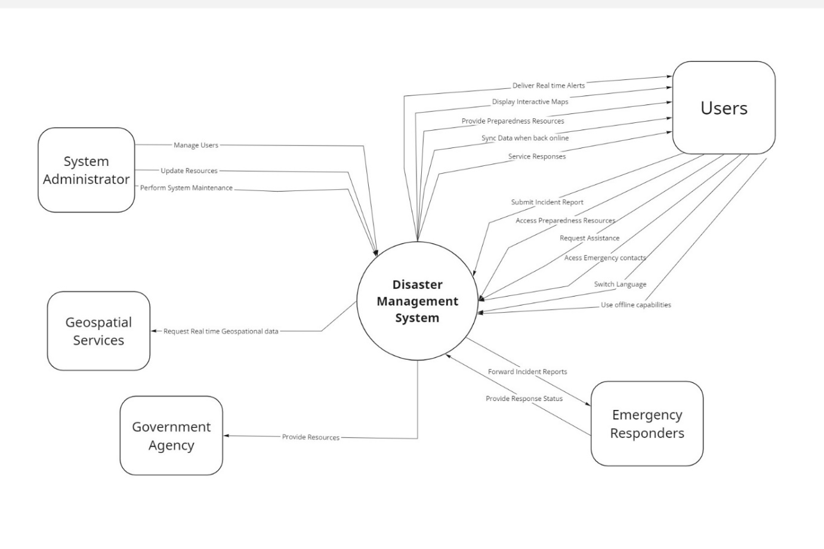

Slide 9
03
USE CASE DIAGRAM
The use case diagram is a visual representation that illustrates how users (actors) interact with a system.
For our system, the use case diagram consists of the following three actors
01
01
02
03
System Actors
Primary Actors
Secondary Actors
01
USERS/CITIZENS
EMERGENCY RESPONDERS
GOVERNMENT AGENCIES
SYSTEM ADMINISTRATOR

Slide 10
USE CASES FOR THE VARIOUS ACTORS
USER/CITIZEN
REPORT INCIDENTS
REQUEST EMERGENCY ASSISTANCE
RECEIVE ALERTS AND NOTIFICATIONS
ACCESS PREPAREDNESS RESOURCES
ACCESS EMERGENCY INFO
ACCESS EMERGENCY CONTACT
MULTILANGUAGE SUPPORT
LOGIN

Slide 11
EMERGENCY RESPONDERS
RECEIVE INCIDENT REPORT
DISSEMINATE EMERGENCY INFORMATION
PROVIDE MEDICAL ASSISTANCE
LOGIN
SYSTEM ADMINISTRATOR
MANAGE USER ACCOUNT
MAINTAIN THE SYSTEM
UPDATE RESOURCES

Slide 12
GOVERNMENT AGENCIES
PROVIDE RESOURCES
MANAGE EMERGENCY RESOURCES
DISSEMINATE PUBLIC INFORMATION

Slide 13
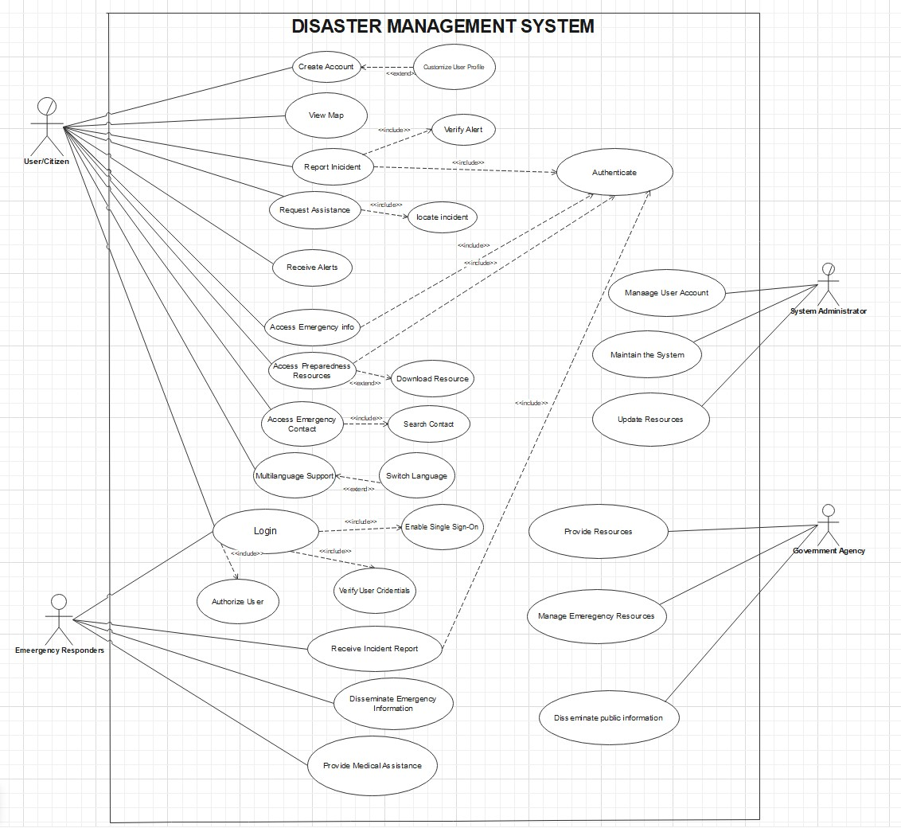

Slide 14

CLASS DIAGRAM
04
The Class Diagram visually represents the structure of a system by showing the system’s classes, their attributes, operations (or methods), and the relationships among objects.

Slide 15
The Various Classes in our Class Diagram
06
Incident Reporting:
01
User
07
02
Location:
02
System:
08
Geospatial Mapping Services:
03
Emergency Resources:
09
Offline Functionalities:
04
Alert/Notification:
10
Multilanguage Support:
05
Preparedness and Mitigation:
11
Category:

Slide 16
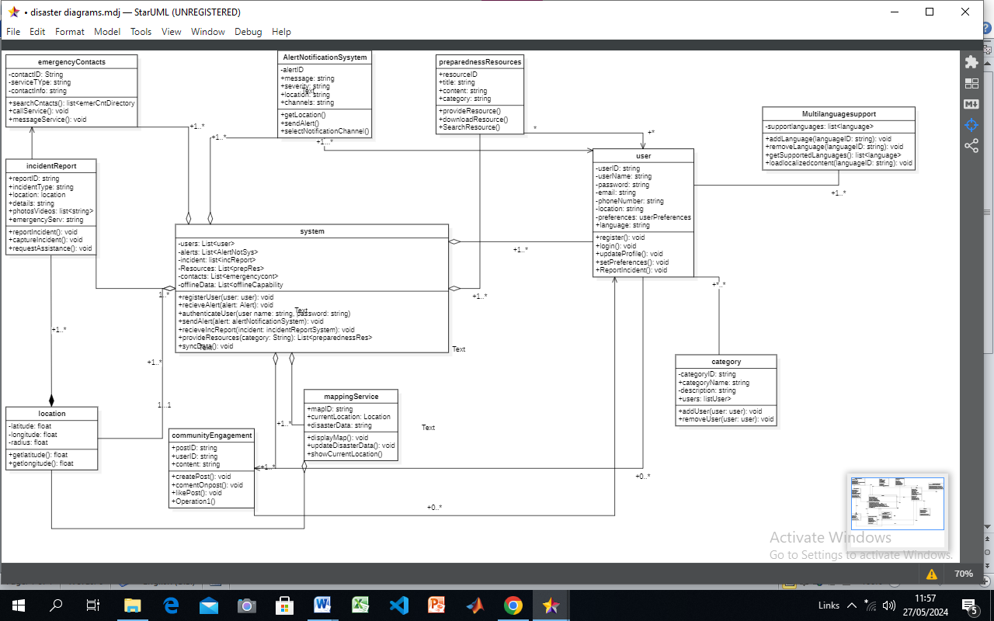

Slide 17

05
SEQUENCE DIAGRAM
A sequence diagram for a disaster management mobile app illustrates the interactions and order of events between different components or actors within the system

Slide 18
The Various Objects in our System
01
User:
07
Location:
02
System:
08
Preparedness and Mitigation:
03
Alert/Notification:
09
Multilanguage Support:
04
Emergency Resources/Responders:
10
Offline Functionalities:
05
Incident Reporting:
11
Geospatial Data:
06
Category:
12
System Updates:

Slide 19
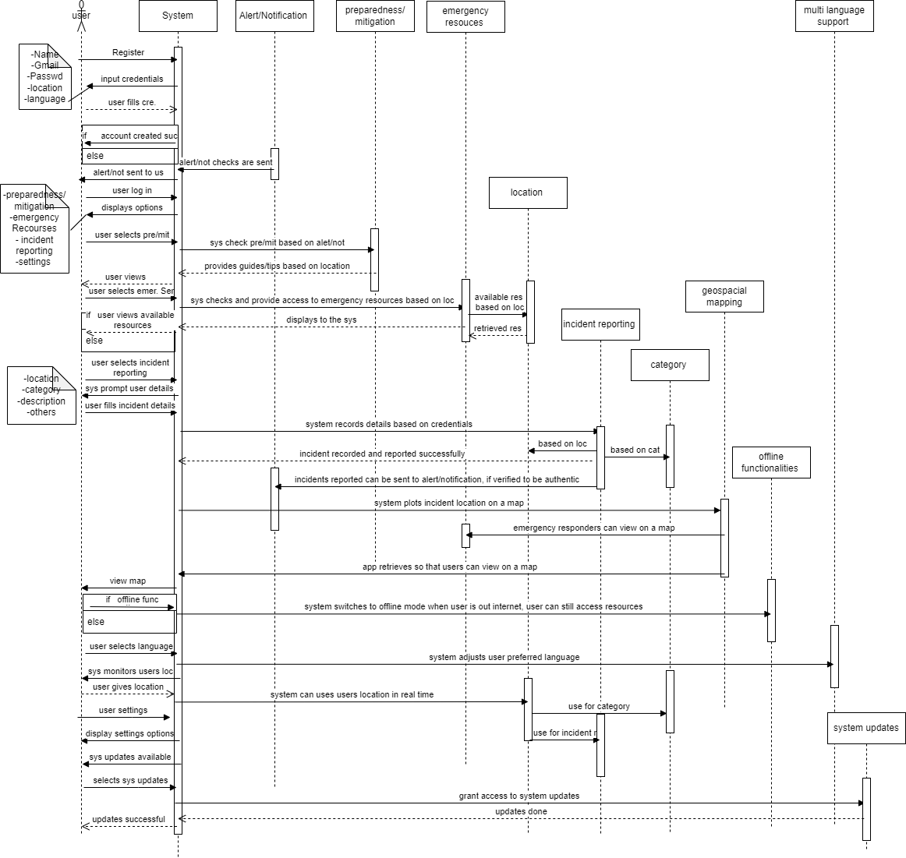

Slide 20

06
DEPLOYMENT DIAGRAM
The Deployment Diagram illustrates how software components and hardware nodes interact and are distributed across a network or infrastructure.

Slide 21
The Various components of the Deployment Diagram
USERS:
MOBILE NETWORK:
REACT NATIVE APP (FRONTEND):
CONTENT DELIVERY NETWORK (CDN)
NODE.JS API SERVER (BACKEND):
API GATEWAY (OPTIONAL):
CLOUD LOAD BALANCER:
MONGODB DATABASE:

Slide 22
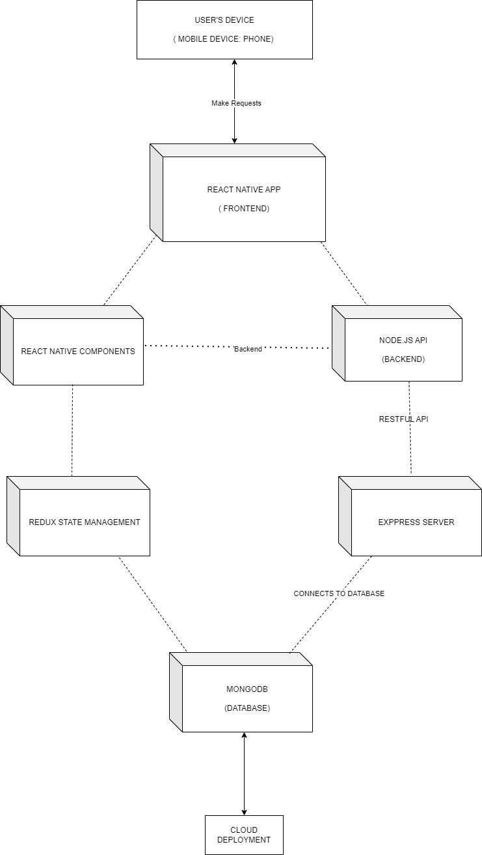

Slide 23
CONCLUSION
Disaster management is a critical area that requires efficient and effective coordination among various stakeholders and users. Mobile applications can play a significant role in disaster management by providing real-time information, enabling communication, and facilitating coordination.

